Slide 1
Online Auction
Nguyễn Hoàng Sơn
Tăng Thế Cường

Slide 2
Requirement
Program Design
Demo

Slide 3
Requirement
Simulate a real auction
Server select goods and start auction
Countdown period to for each bid
User register and log in system
Join and bid with their money
New bid is updated to every bidder
Winner is declared after a period of time
User can deposit money to account
User can see history of bidding

Slide 4
Program Design
2.1. Multiple Connection Handling
Concurrent single server.
Wait for connection on all open socket.
Wake up on triggered activity.
Handle connection activities one by one.
Handle unexpected disconnection.

Slide 5
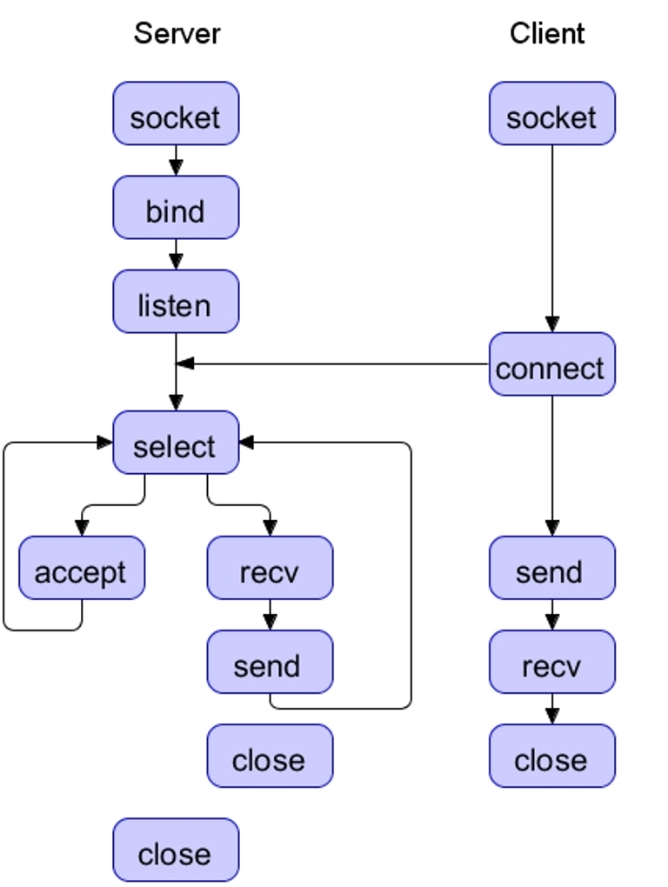
Design
2.1. Multiple
Connection
Handling

Slide 6
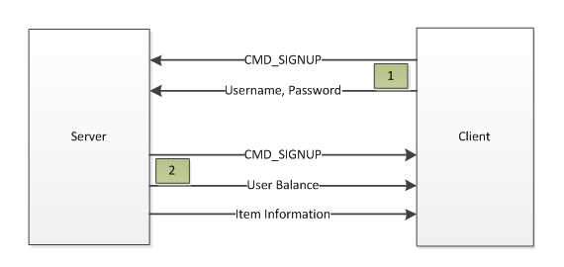
Program Design
2.2. Register user account
Enter User name and password on client.
Send to server.
Get logged in if register successfully.

Slide 7
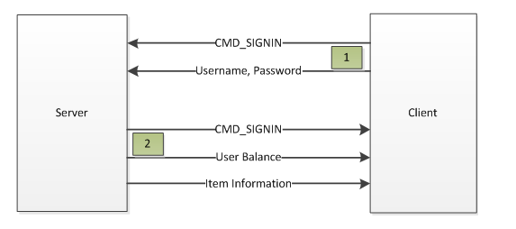
Program Design
2.3. Log in
Enter User name and password on client.
Send to server.
Get logged in if log in successfully.

Slide 8
Program Design
2.4. Auction process on server
List of goods is loaded on server.
Select one to auction.
60 seconds countdown for first join.
60 seconds countdown for first bid.
3 phases of 20 seconds for each bid.
Update new bid instantly to all bidder.
Winner is declared after 3 phases.
Highest bid is backed to previous one in case of disconnection.

Slide 9
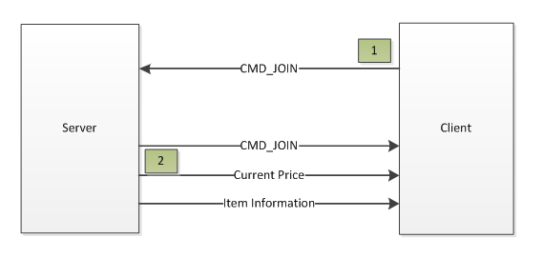
Program Design
2.5. Join auction & bid on client
User can’t join if account balance is lower than price.

Slide 10
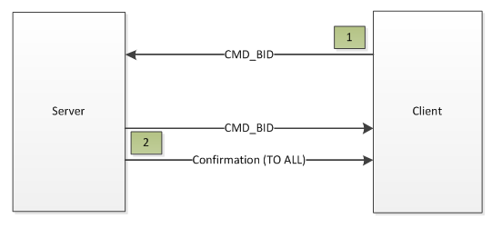
Program Design
2.5. Join auction & bid on client
Enter bid money and sent to server.
Bid money >= Current price + Step Size
Force to quit on spamming low bid.

Slide 11
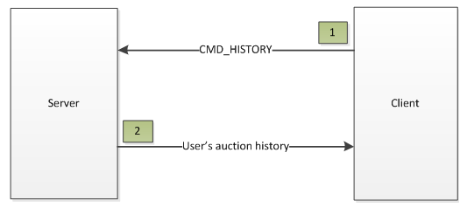
Program Design
2.6. Bidding History
Goods name + Winning Price + Date & Time

Slide 12
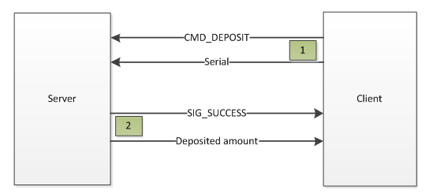
Program Design
2.7. Deposit Money
Enter serial and send to server.
Server looks for serial.
Update account balance if serial is found.

Slide 13
Demo

Slide 14
Thanks for listening!

